Slide 1
HTML and CSS
Milan Ojsteršek

Slide 2
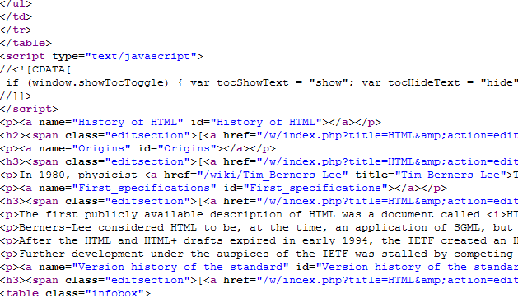
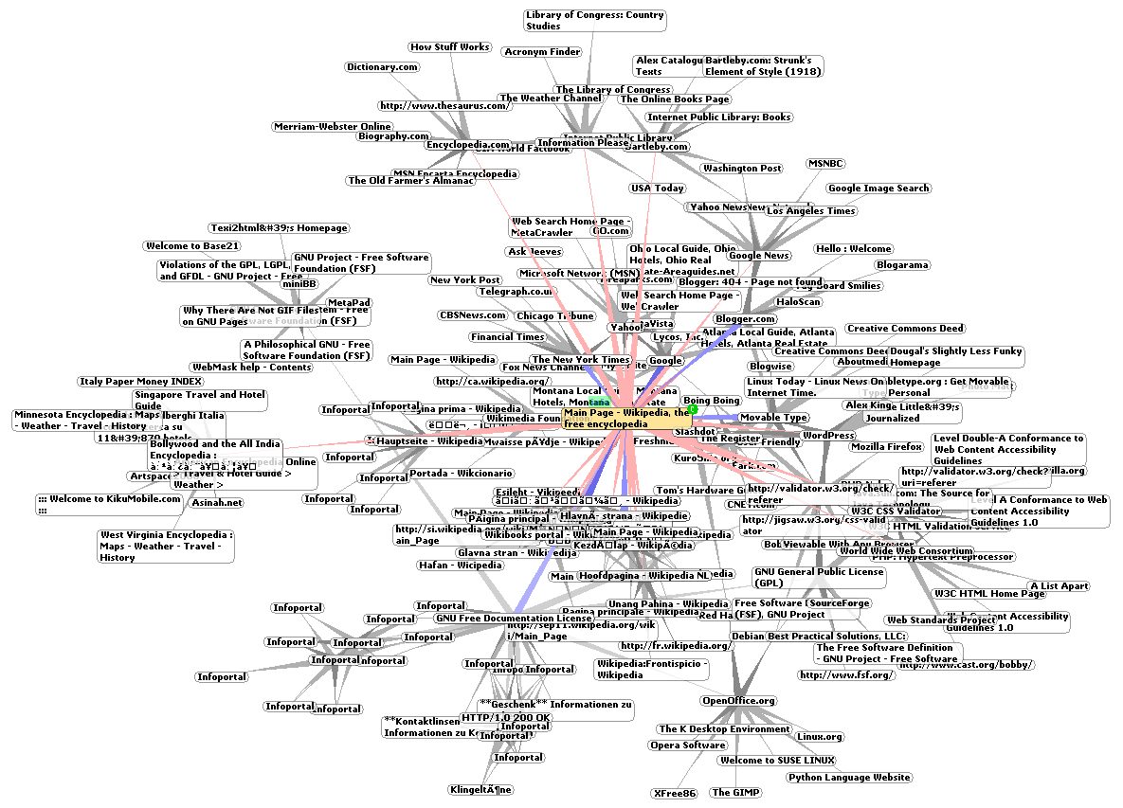
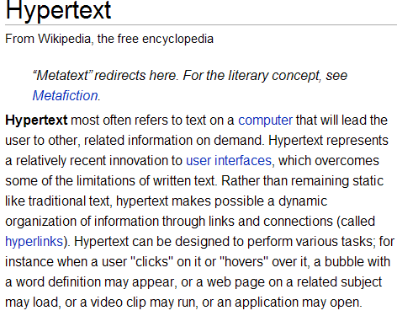
WWW (Word Wide Web)
Notes:
HTML (HyperText Markup Language) je jezik, s katerim opišemo gradiva, ki jih želimo objaviti na spletu.
Datoteka HTML (uporabljata se končnici .htm ali .html), je običajna znakovna datoteka, kar pomeni, da jo lahko odpremo in urejamo s poljubnimi urejevalniki besedil.

Slide 3
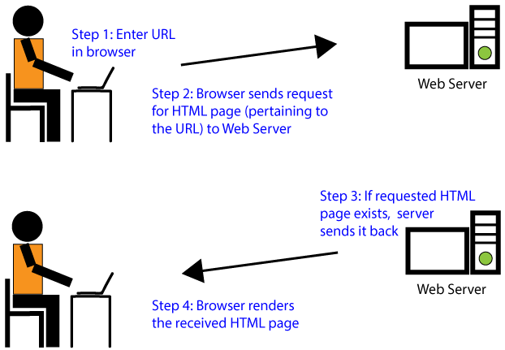

Slide 4
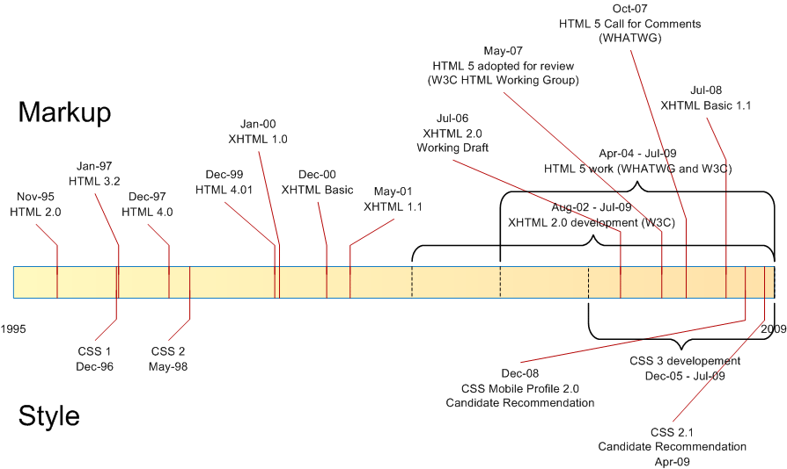
History of HTML

Slide 5
First HTML
<!DOCTYPE html>
<html>
<head>
<title>Page Title</title>
</head>
<body>
<h1>My First Heading</h1>
<p>My first paragraph.</p>
</body>
</html>

Slide 6
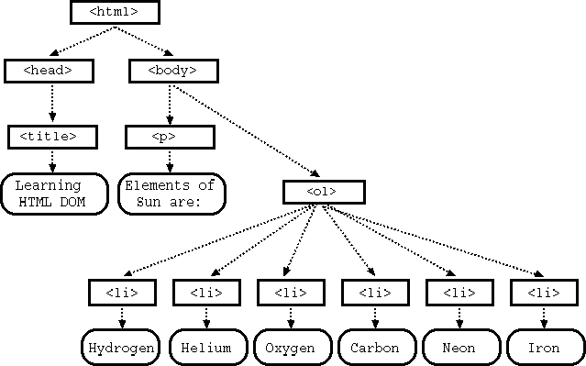
DOM (Document Object Model) tree

Slide 7
HTML head
<head> <title>Page Title</title>
<meta charset="UTF-8"> <meta name="description" content="Free Web tutorials"> <meta name="keywords" content="HTML,CSS,XML,JavaScript"> <meta name="author" content="John Doe">
<meta name="viewport" content="width=device-width, initial-scale=1.0">
<style> body {background-color: powderblue;} h1 {color: red;} p {color: blue;} </style>
<link rel="stylesheet" href="mystyle.css">
<link media= "value" />
<script> function myFunction { document.getElementById("demo").innerHTML = "Hello JavaScript!"; } </script>
</head>

Slide 8
Important links for HTML
W3C
W3Schools
HTML Tag Reference
XHTML syntax
HTML validation service
MIME Types
Charsets, Entities and Symbols
http://caniuse.com/
http://html5test.com/
Which attributes is possible to use in HTML5 forms

Slide 9
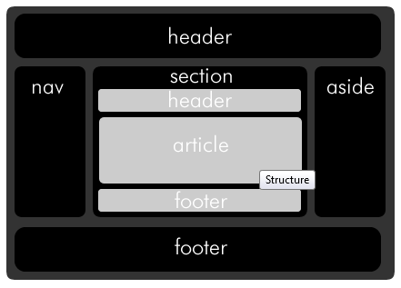
HTML5 semantic tags

Slide 10
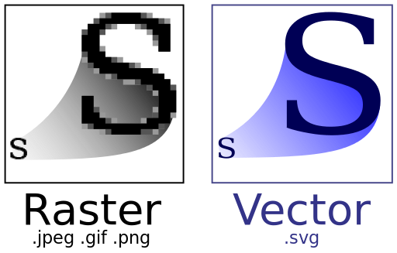
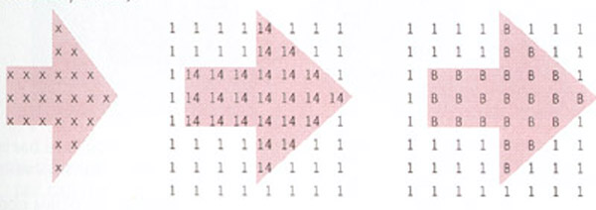
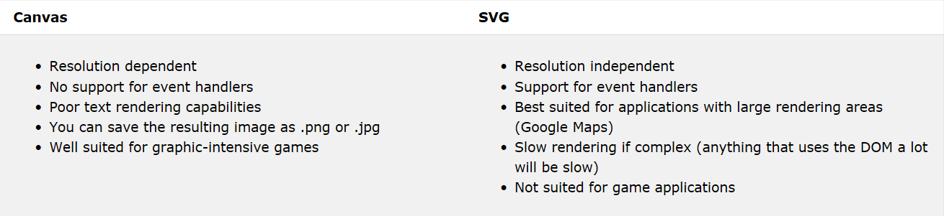
Multimedia
Images SVG
HTML5 audio and video reference
SVG stands for Scalable Vector Graphics
SVG is used to define graphics for the Web
SVG is a W3C recommendation

Slide 11
HTML attributes
Global attributes
HTML attributes give elements meaning and context.
The global attributes below can be used on any HTML element.
Event attributes
events trigger actions in a browser, like starting a JavaScript when a user clicks on an element.
Events triggered for the window object (applies to the <body> tag)
Events triggered by actions inside a HTML form (applies to almost all HTML elements, but is most used in form elements)

Slide 12
CSS
Cascading Style Sheets (CSS) tell the browser how to display the text and other content that you write
in HTML. Note that CSS is case-sensitive so be careful with your capitalization. CSS has been adopted by all
major browsers and allows you to control:
color
fonts
positioning
spacing
sizing
decorations
transitions
There are three main ways to apply CSS styling. You can apply inline styles directly to HTML elements with
the style attribute. Alternatively, you can place CSS rules within style tags in an HTML document. Finally, you can write
CSS rules in an external style sheet, then reference that file in the HTML document. Even though the first two options
have their use cases, most developers prefer external style sheets because they keep the styles separate from the HTML elements.
This improves the readability and reusability of your code. The idea behind CSS is that you can use a selector
to target an HTML element in the DOM (Document Object Model) and then apply a variety of attributes to that element to change
the way it is displayed on the page.

Slide 13
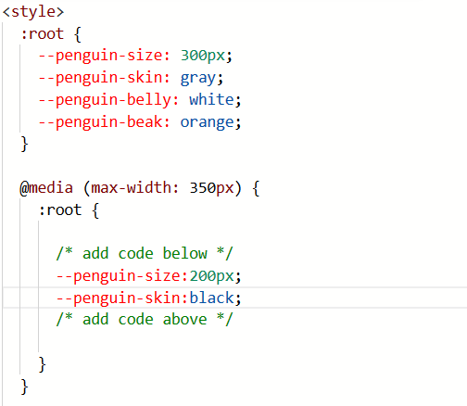
When you create a variable, it becomes available for you to use inside the element in which you create it. It also becomes available within any elements nested within it. This effect is known as cascading.
Because of cascading, CSS variables are often defined in the :root element.
You can think of the :root element as a container for your entire HTML document, in the same way that an html element is a container for the body element.
By creating your variables in :root, they will be available throughout the whole web page.
CSS Variables can simplify the way you use media queries.
For instance, when your screen is smaller or larger than your media query break point, you can change the value of a variable, and it will apply its style wherever it is used.

Slide 14
CSS example
<!DOCTYPE html>
<html>
<head>
<style>
.center {
text-align: center;
color: red;
}
</style>
</head>
<body>
<h1 class="center">Red and center-aligned heading</h1>
<p class="center">Red and center-aligned paragraph.</p>
</body>
</html>

Slide 15
CSS selectors
Examples:
.intro Select and style all elements with class="intro"
#firstname Select and style the element with id="firstname"
p Select and style all <p> elements
h1, p Selects all <h1> elements and all <p> elements
div p Selects all <p> elements inside <div> elements
div > p Select and style every <p> element where the parent is a <div> element
a:hover Selects links on mouse over
a[href^="https"] Selects every <a> element whose href attribute value begins with "https„
p:nth-child(2) Selects every <p> element that is the second child of its parent
::selection Selects the portion of an element that is selected by a user

Slide 16
CSS links
Usage of CSS styles
CSS recomendation on W3C
CSS on W3chools
CSS reference
CSS Zen Garden
Google‘s material design
CSS validator
CSS tricks
CSS dynamic drive

Slide 17
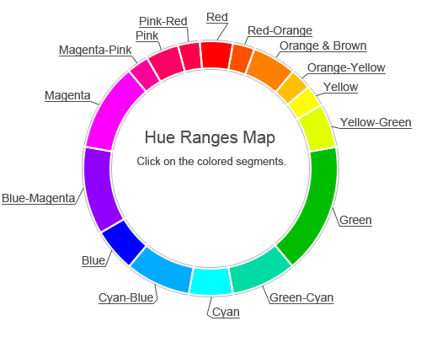
CSS colors and Color tutorial
http://www.w3schools.com/cssref/css_colors_legal.asp
http://en.wikipedia.org/wiki/Adobe_RGB_color_space
http://en.wikipedia.org/wiki/HSL_and_HSV
https://www.w3schools.com/colors/colors_picker.asp
Examples :
#p1 {background-color: #ff0000;}
#p1 {background-color: red;}
#p1 {background-color: rgb(255, 0, 0);}
#p1 {background-color: rgba(255, 0, 0, 0.3);}
#p1 {background-color: hsl(120, 100%, 50%);}
#p1 {background-color: hsla(120, 100%, 50%, 0.3);}

Slide 18

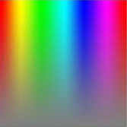

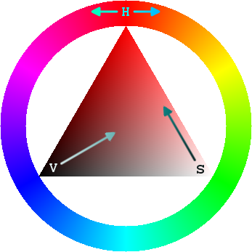
Color features
Complementarity of colors
Saturation of colors

Slide 19
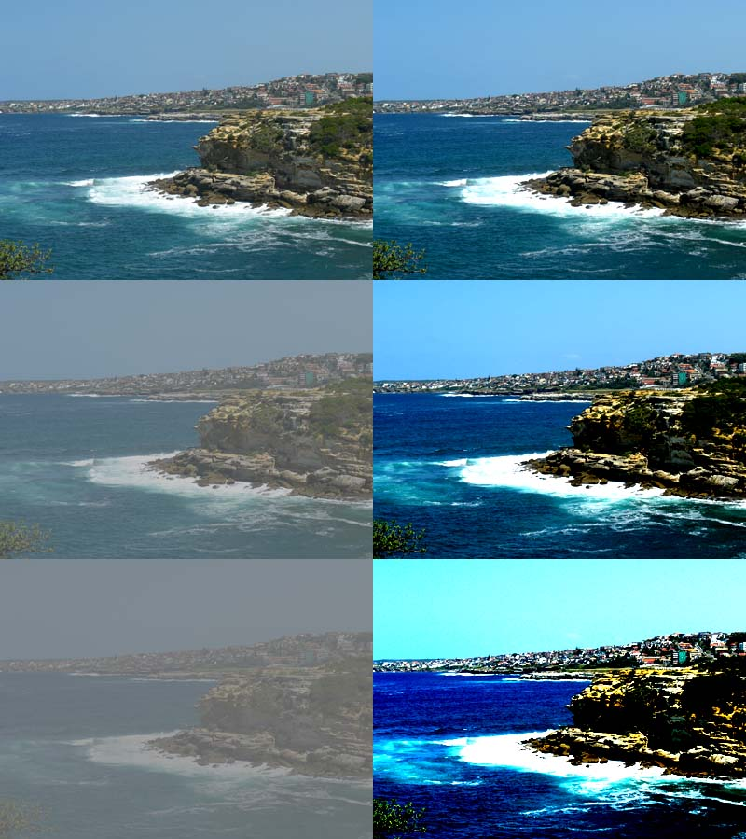
Color features
Contrast
Lightness

Slide 20
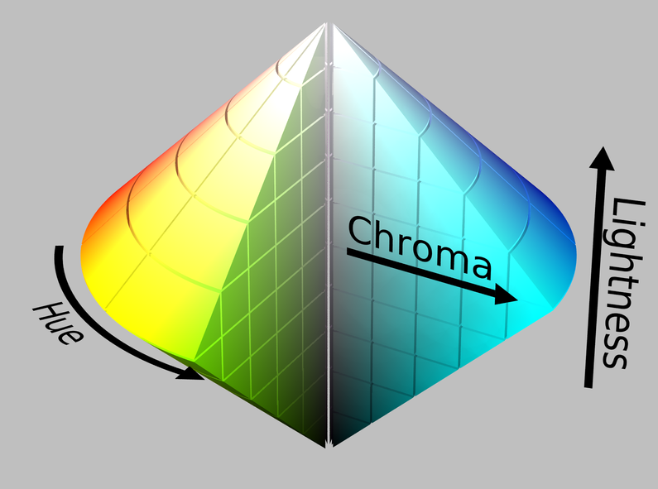
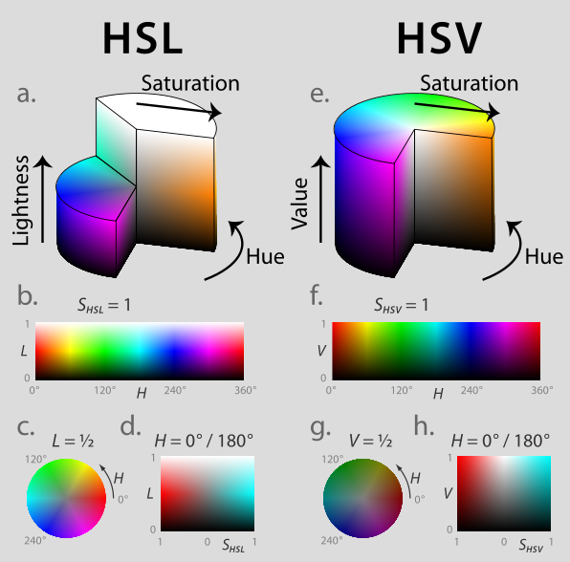
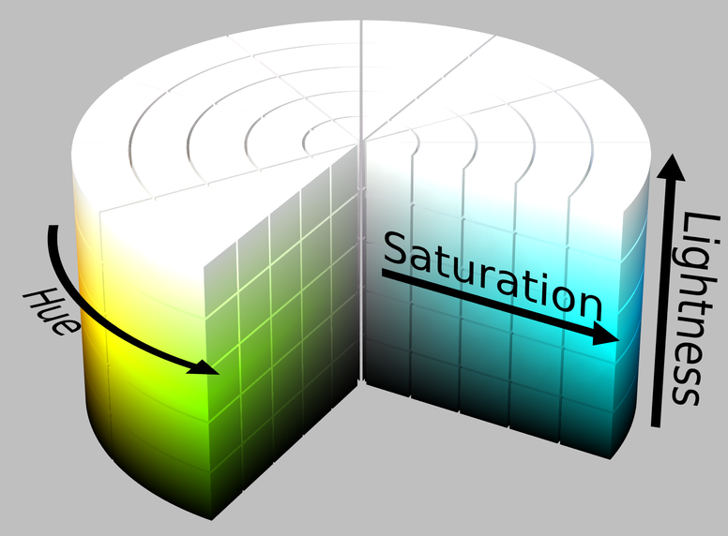
HSL color space
≠
Slike: en.wikipedia.org/wiki/HSL_and_HSV

Slide 21
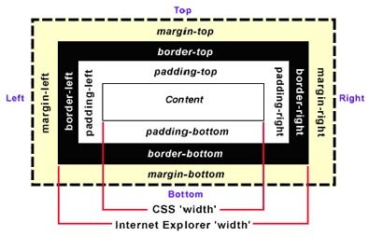
Block and inline elements
<style>
div {
background-color: lightgrey;
width: 300px;
border: 25px solid green;
padding: 25px;
margin: 25px;
}
</style>
CSS units

Slide 22
BOX MODEL
width, height,
align, top, bottom, left, right
max-width, min-width, max-height, min-height
@media
position, float, clear
border, border-radius
background, background-color, background-image
padding, margin, outline
display
z-index
visibility
overflow
box-shadow, box-sizing
object-fit
flex
columns
resize
transform
transition
animation
grid
Definition of type of a browser:
-ms- -moz-, -webkit-, -o-
-webkit-transition: width 2s; /* Safari 3.1 to 6.0 */
-ms-transform: rotate(7deg); /* IE 9 */

Slide 23
Text
font, color, CSS3 fonts, @charset
text, Web safe fonts,
word-break, word-wrap, word-spacing
line-height, letter-spacing
Aural reference

